Slide 1
SECTION 2

Slide 2
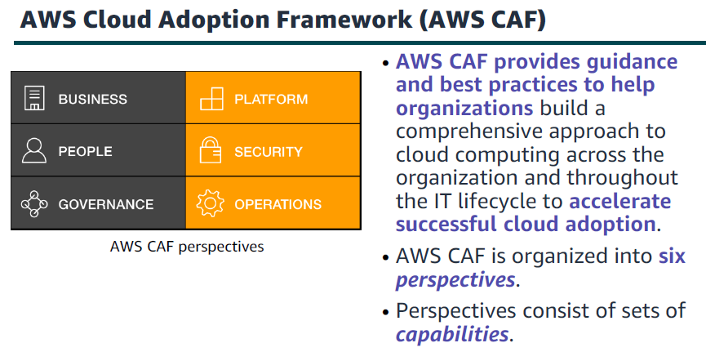

Slide 3
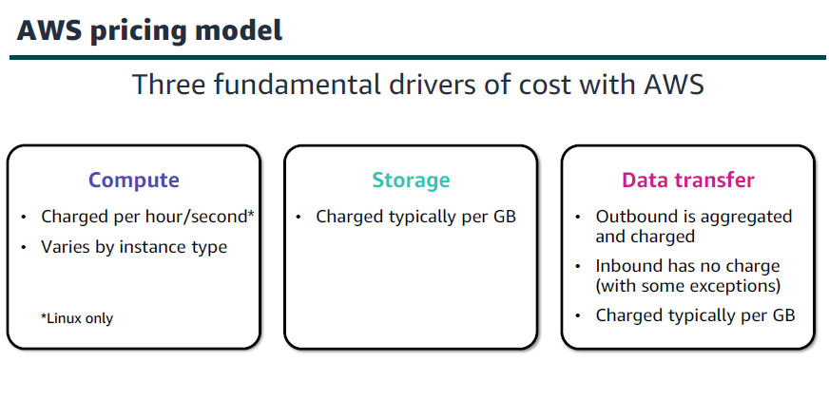

Slide 4
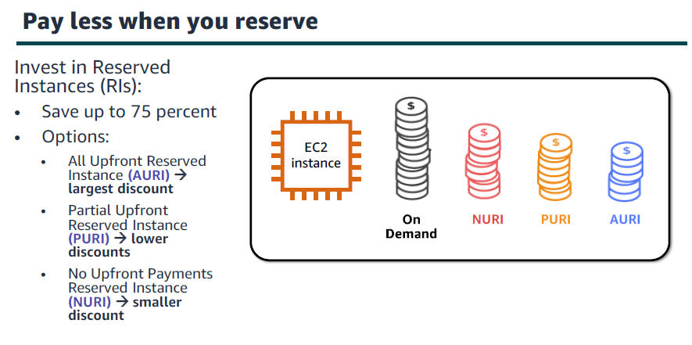

Slide 5
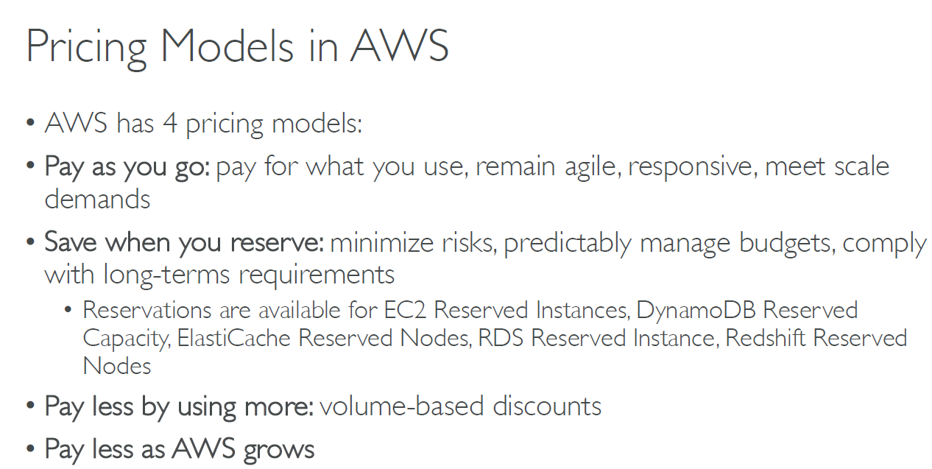

Slide 6
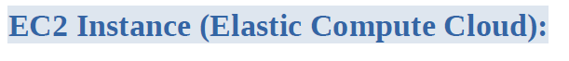
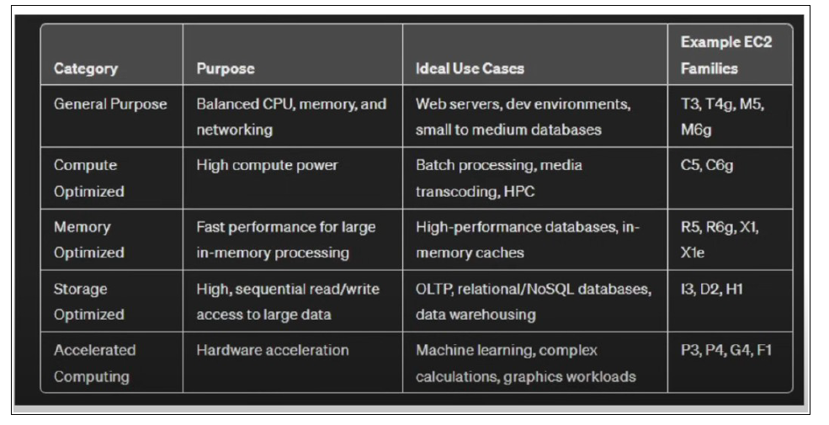

Slide 7

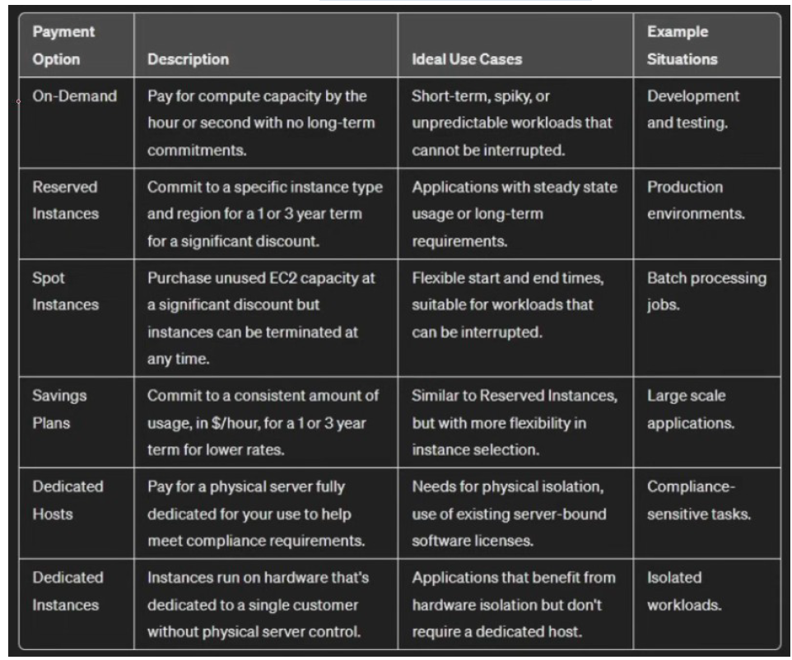

Slide 8

1- AWS Pricing Calculator
Available at https://calculator.aws/
Estimate the cost for your solution architecture.
It is a free tool to use

Slide 9

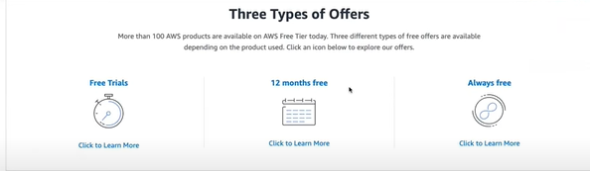
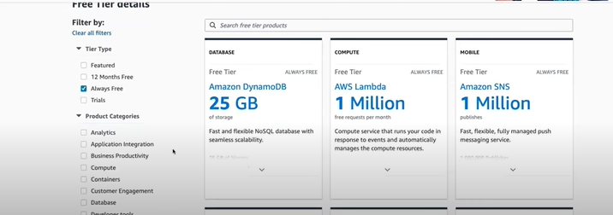

Slide 10
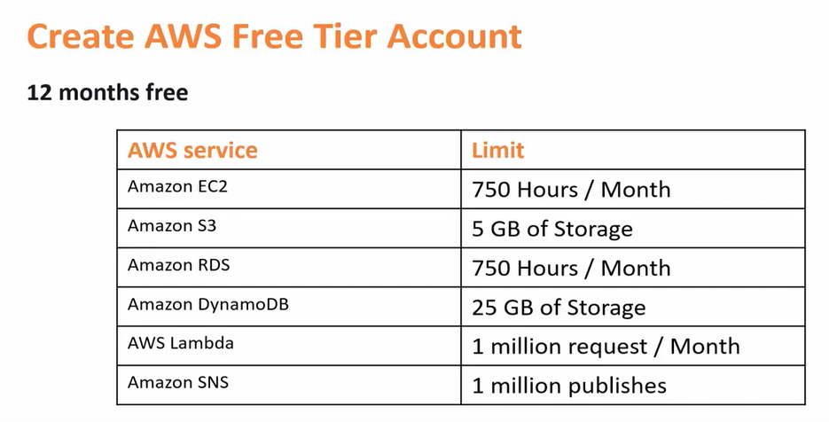
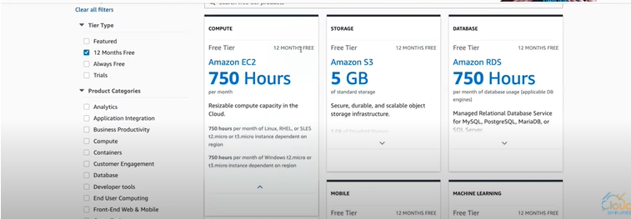

Slide 11
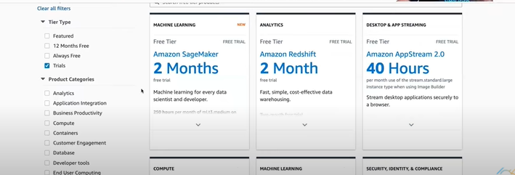

Slide 12
AWS Billing and Cost Management
AWS Budgets: Create budget and send alarms when costs exceeds the budget
Up to 5 SNS notifications per budget
2 budgets are free, then $0.02/day/budget

Slide 13
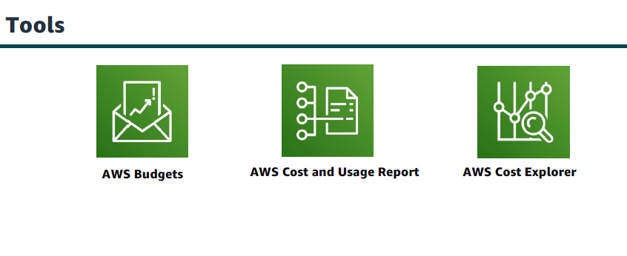
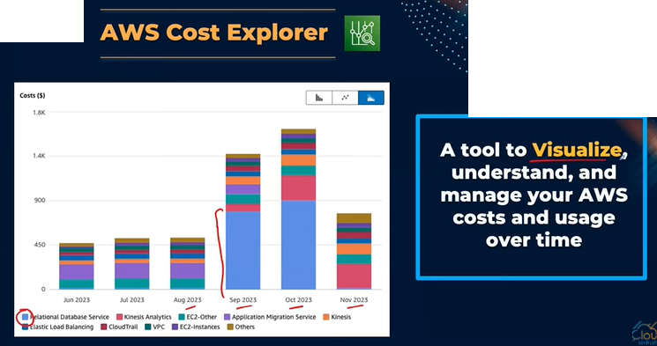

Slide 14
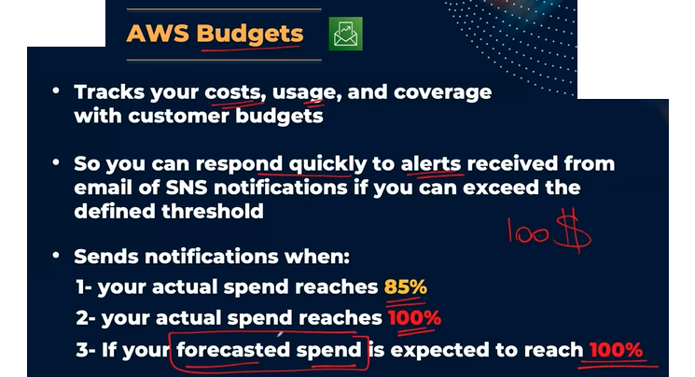

Slide 15
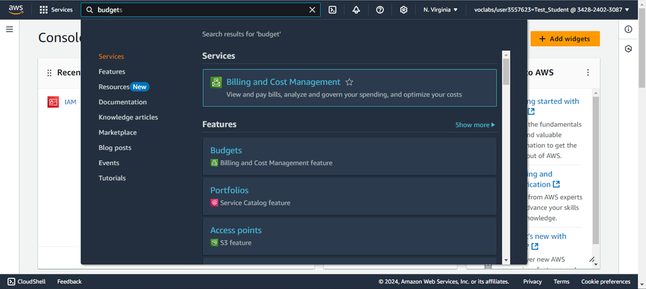
Search for Billing and Cost Management Service

Slide 16
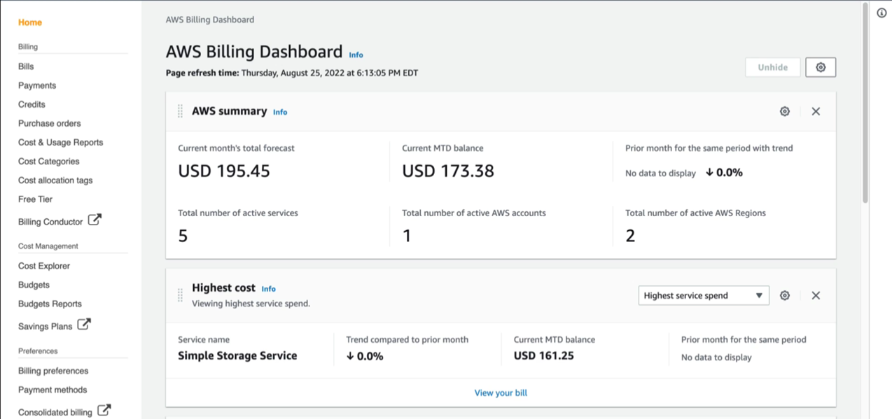
Billing Dashboard

Slide 17
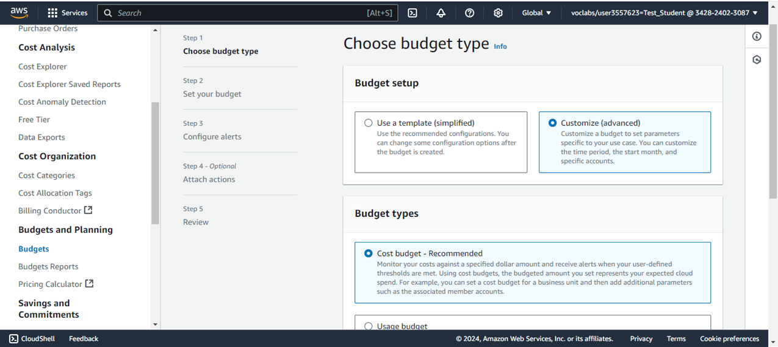
Create a Budget

Slide 18
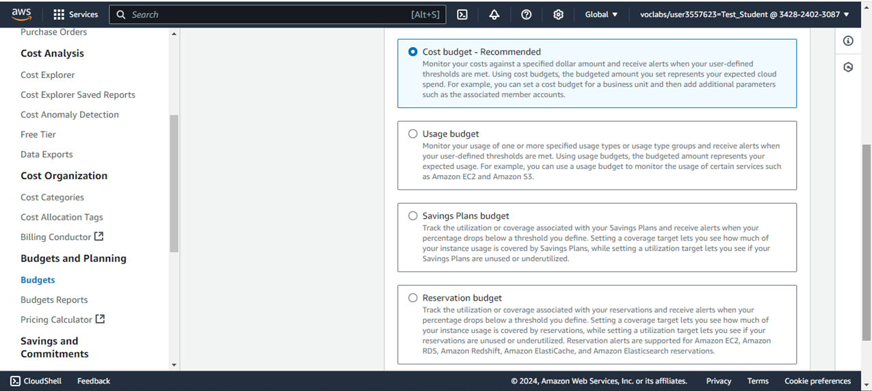
Select Budget Type

Slide 19
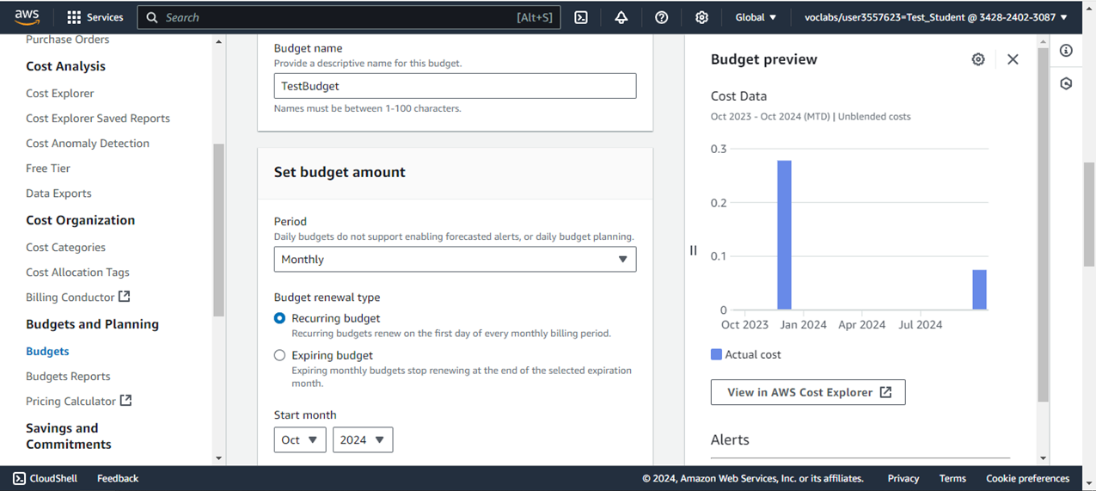
Configure Budget Name and Period

Slide 20
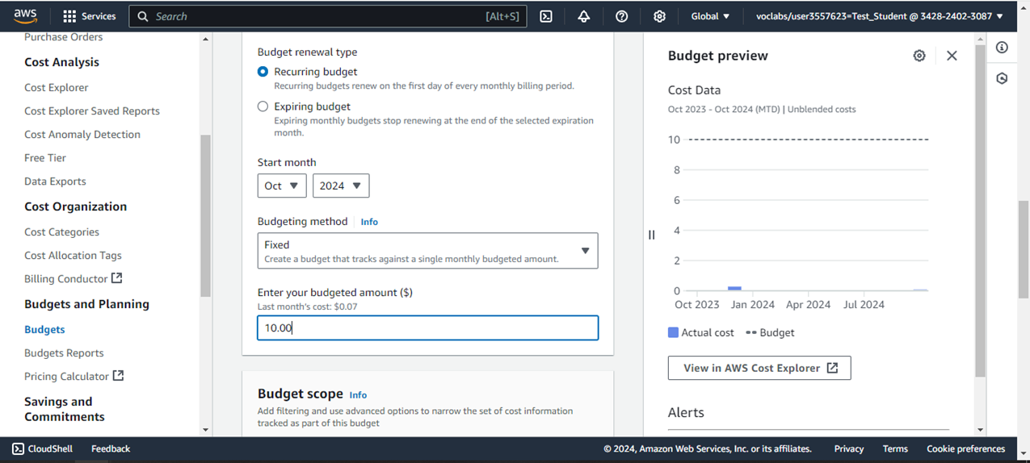
Enter the Budget Amount

Slide 21
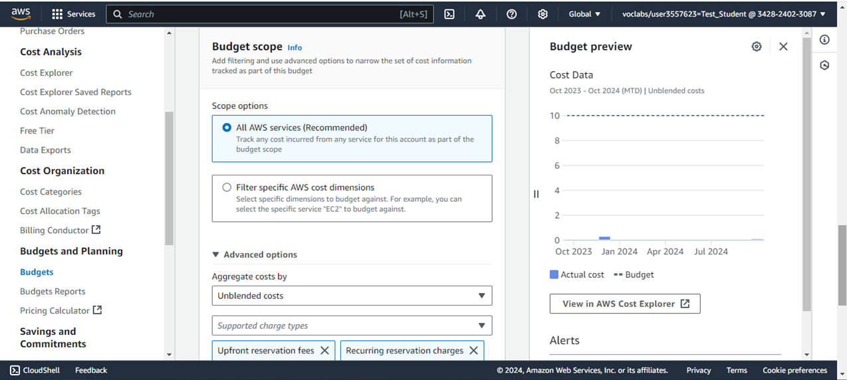
Configure a Budget Scope

Slide 22
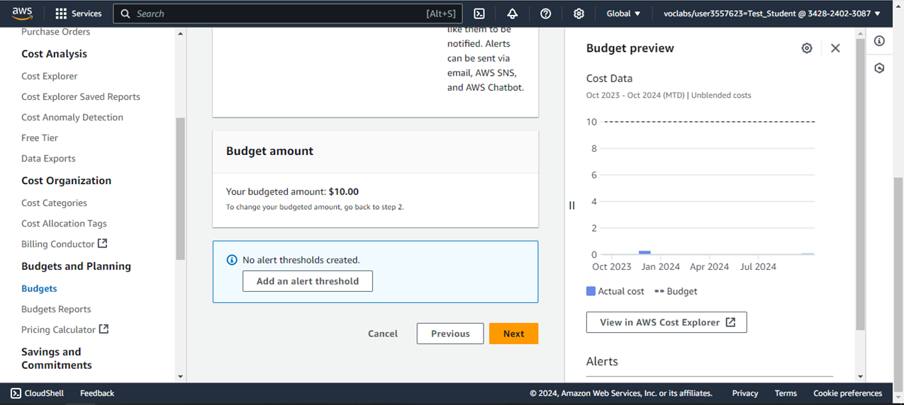
Add an Alert Threshold

Slide 23
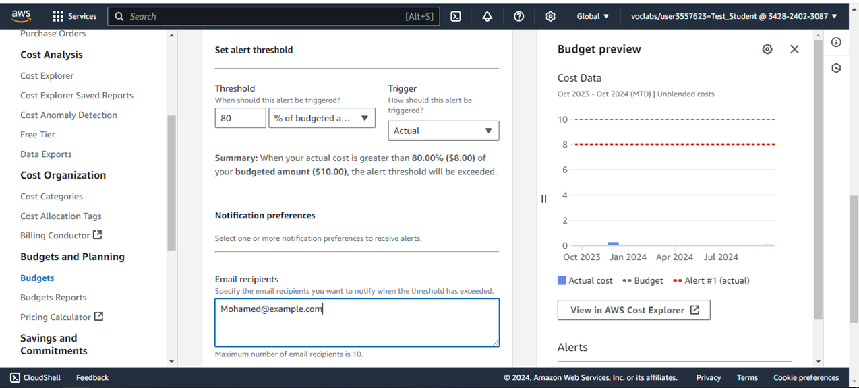
Configure the Threshold, and Recipient Email

Slide 24
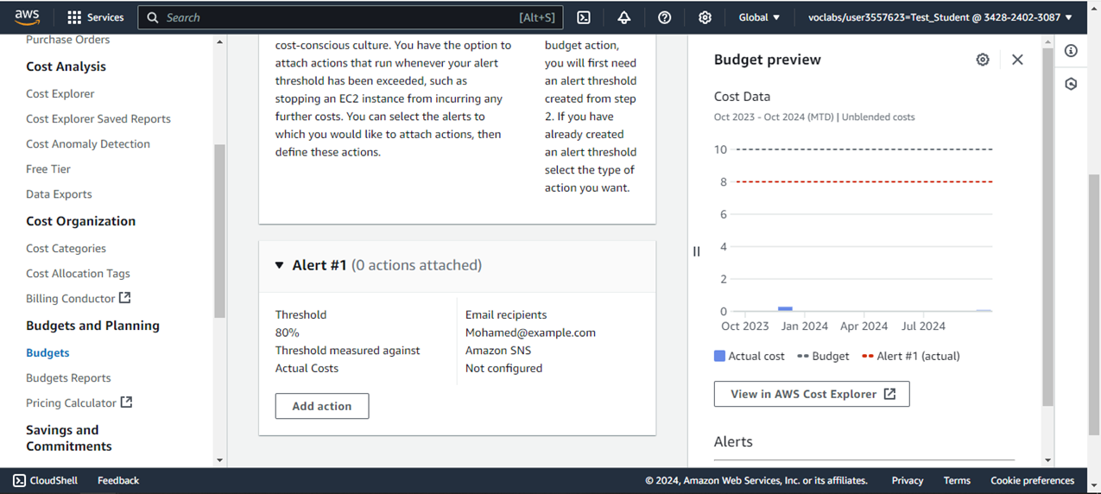
You can add an action when the threshold is reached (Optional)

Slide 25
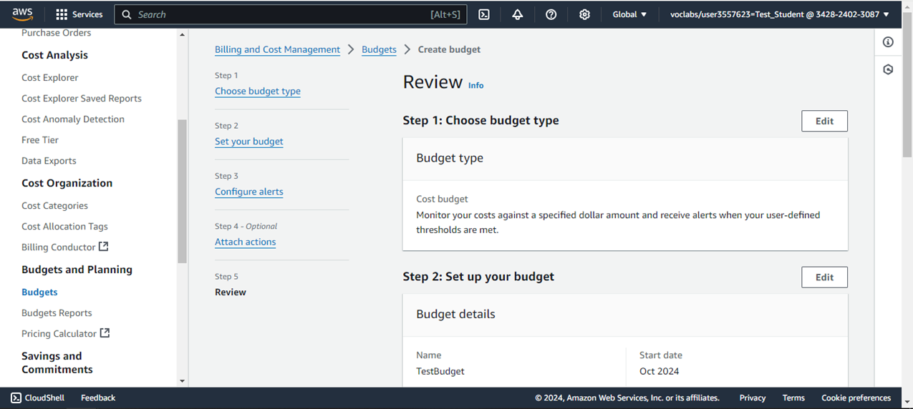
Review the Budget

Slide 26
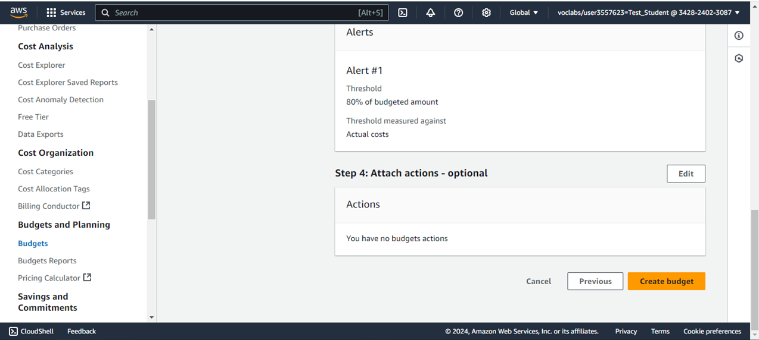
Create Budget

Slide 27
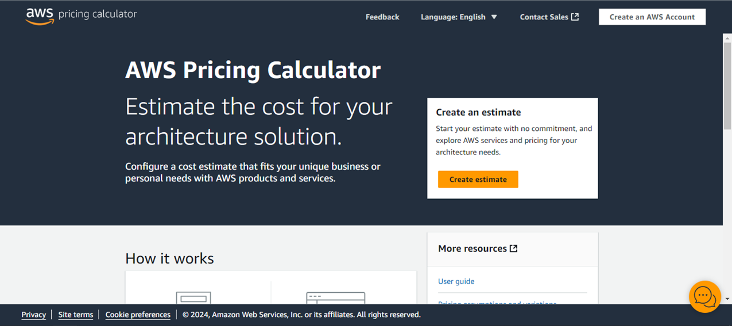
Create an estimation

Slide 28
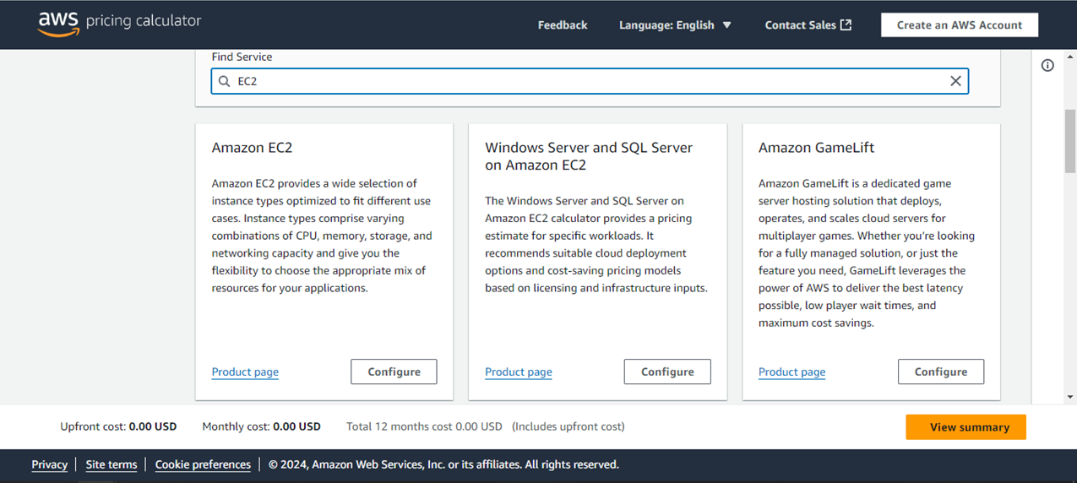
Search for a Service

Slide 29
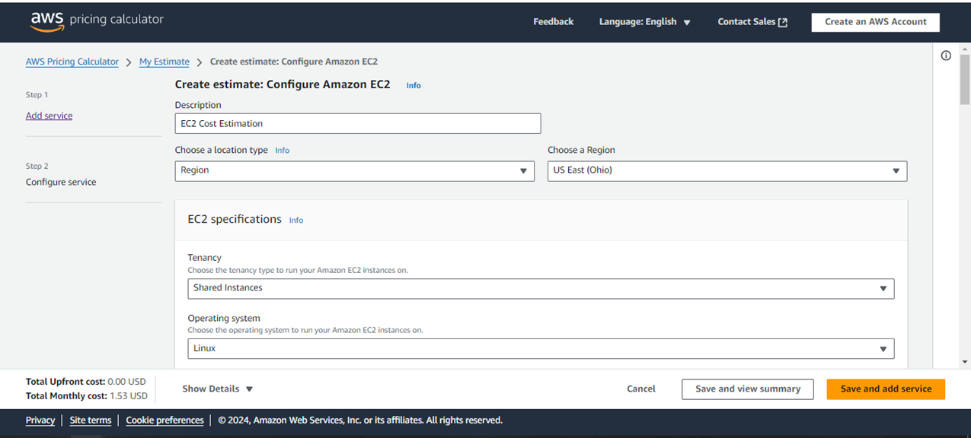
Configure the Region, price may vary depending on region.

Slide 30
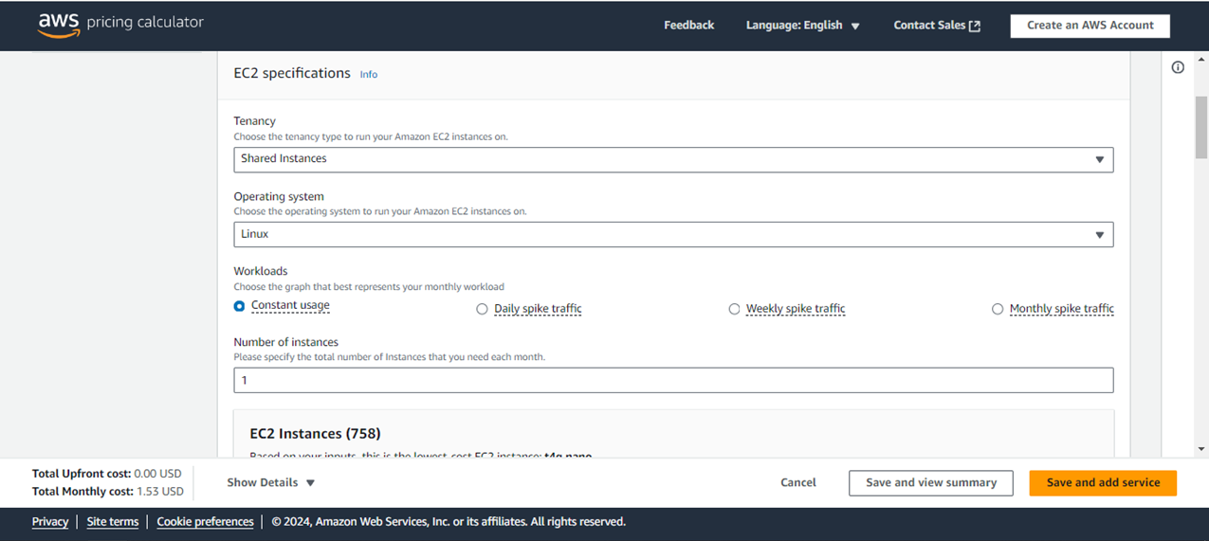
Configure Instance Specifications

Slide 31
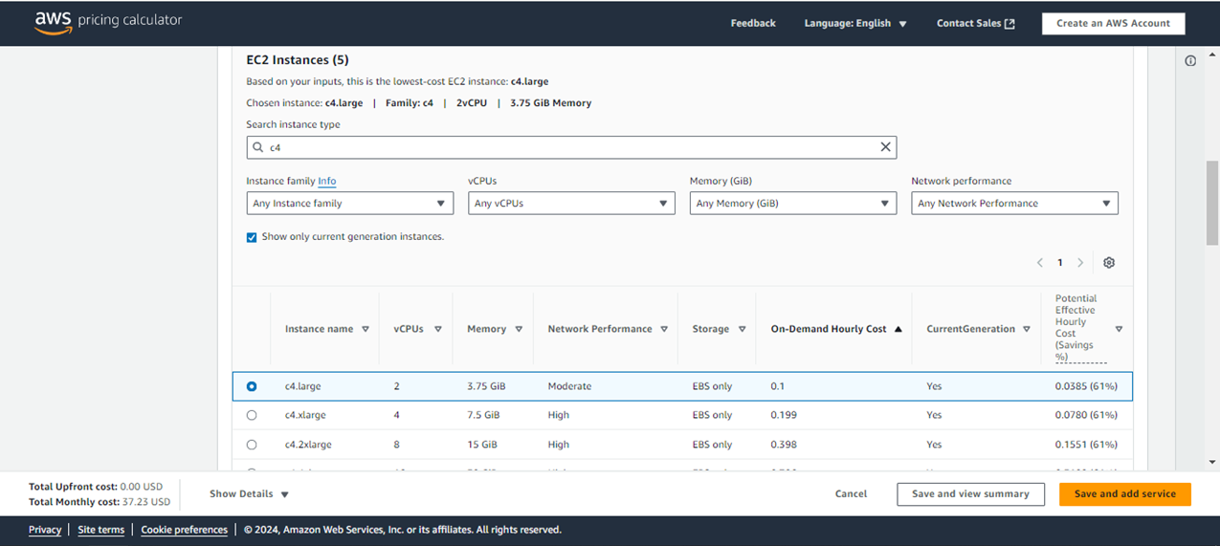
OR
Configure Instance Family and Capabilities

Slide 32
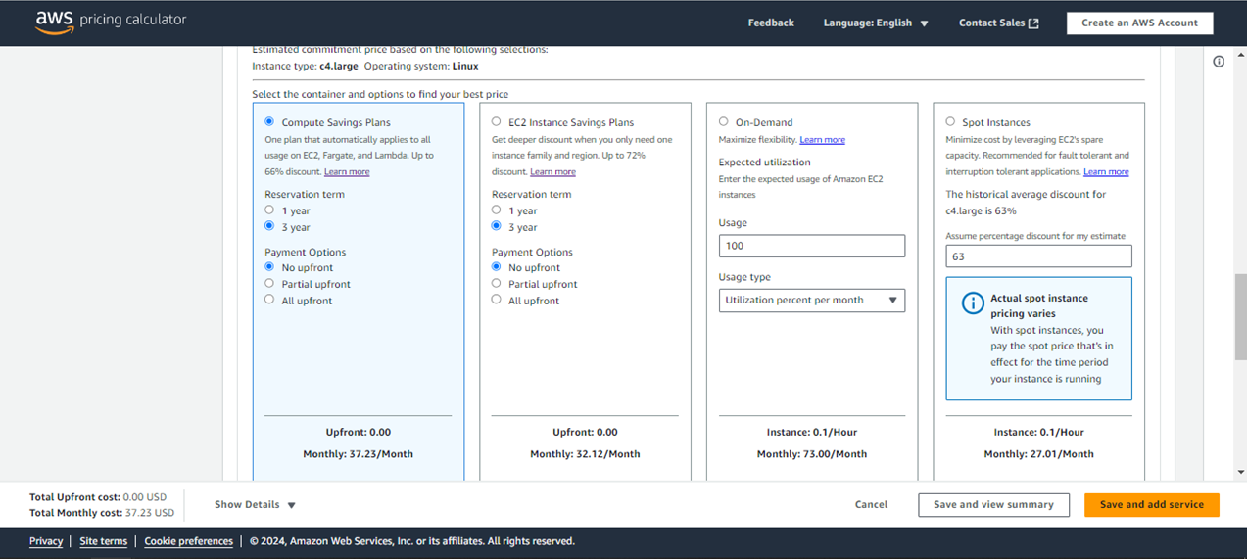
Select a Pricing Strategy

Slide 33
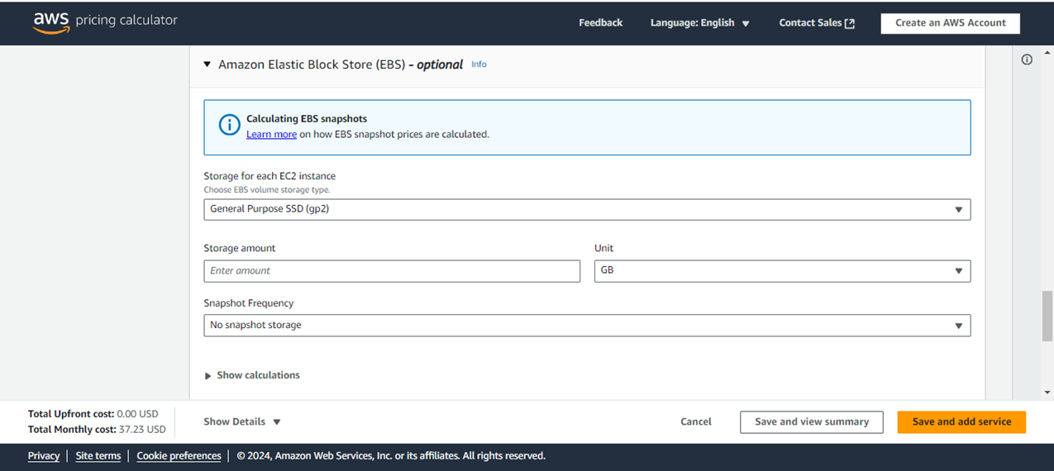
Configure a Storage if needed

Slide 34
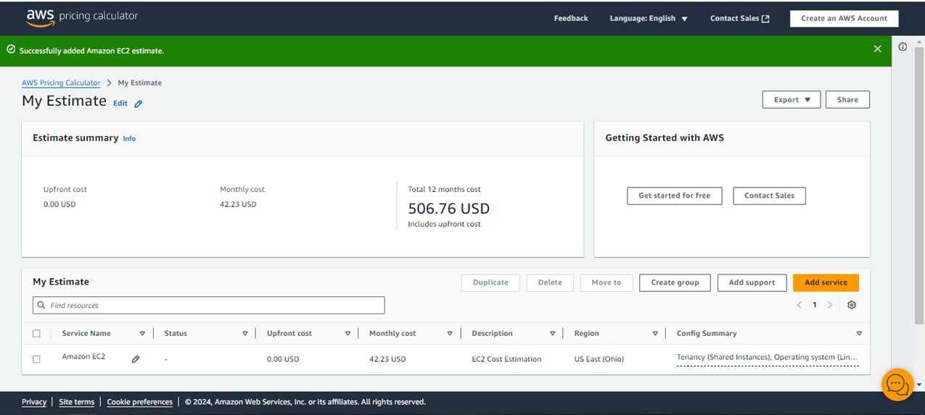
The Estimated Cost, you can also add another service if needed

Slide 35
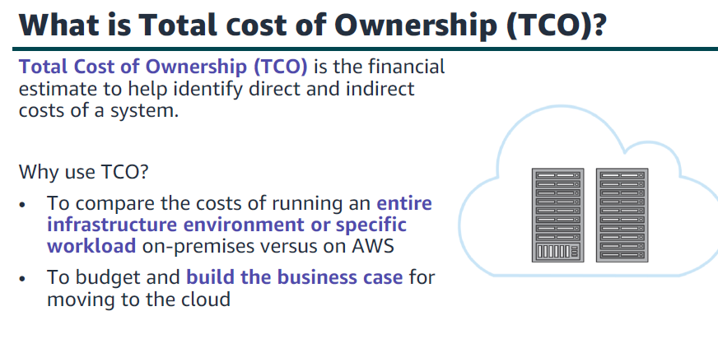

Slide 36
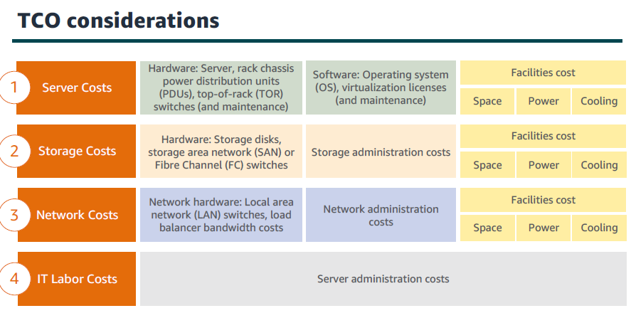

Slide 37
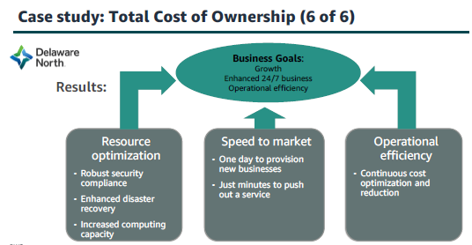

Slide 38
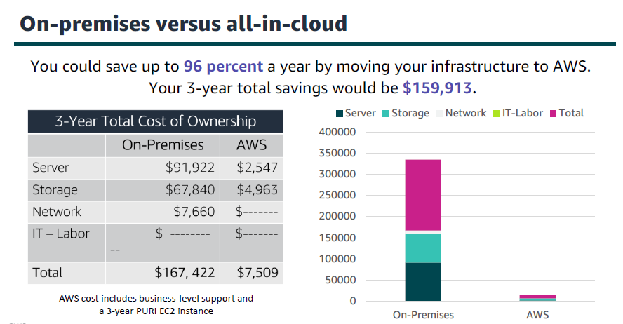

Slide 39
Customer Success Stories
Real-life examples of how businesses and organizations have leveraged AWS services to solve problems and improve costs.
Available at https://aws.amazon.com/solutions/case-studies/

Slide 40
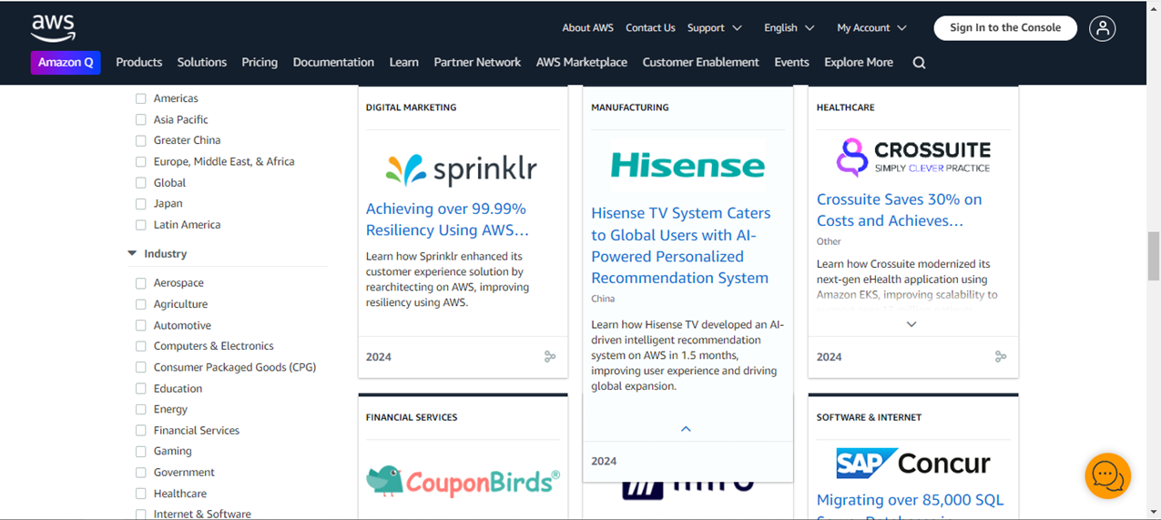
Customer Success Stories

Slide 41
AWS Documentation
Available at https://docs.aws.amazon.com/
An official set of guides and resources to help users to understand and manage AWS services.

Slide 42
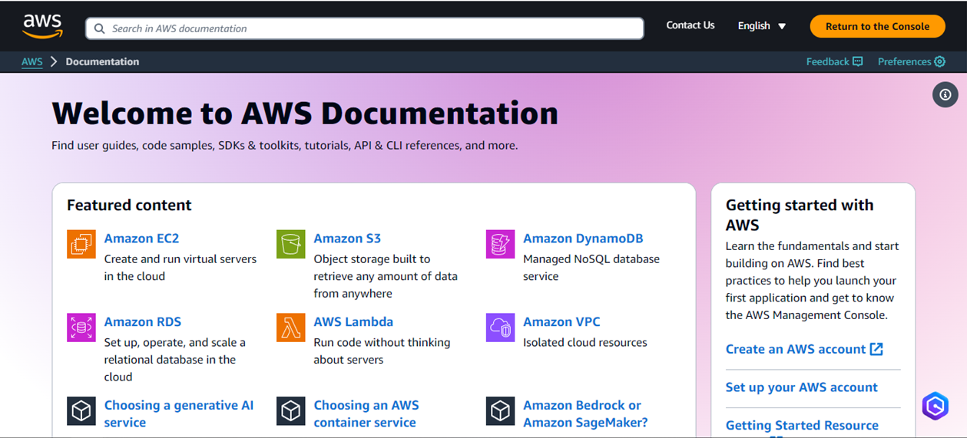
Search for a Service

Slide 43
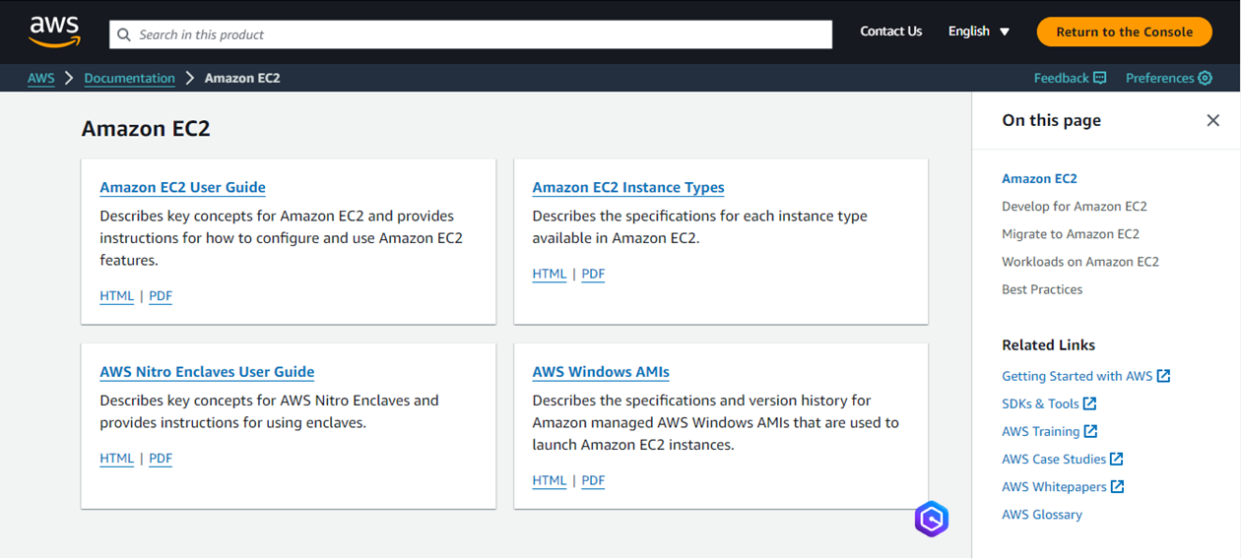
All Documentations Related to EC2 Instances

Slide 44
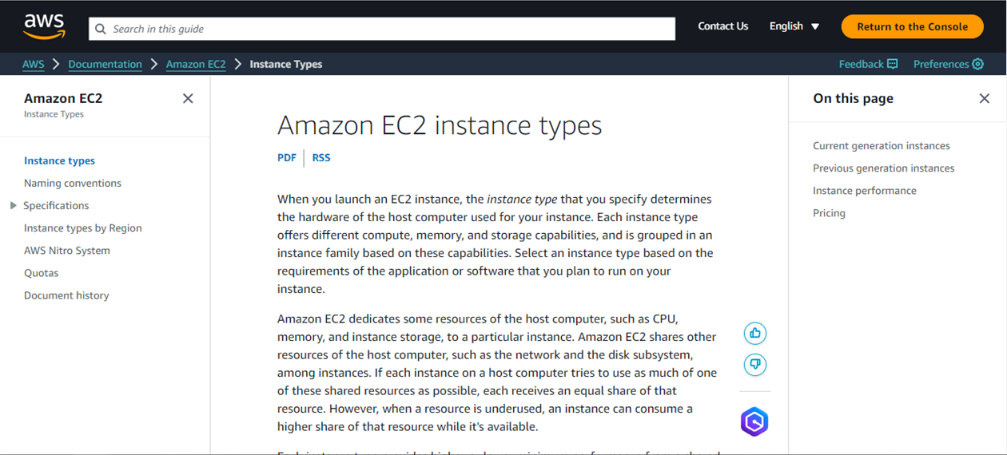
Amazon EC2 Instance Types

Slide 45
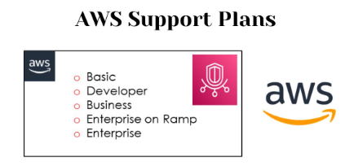

Slide 46
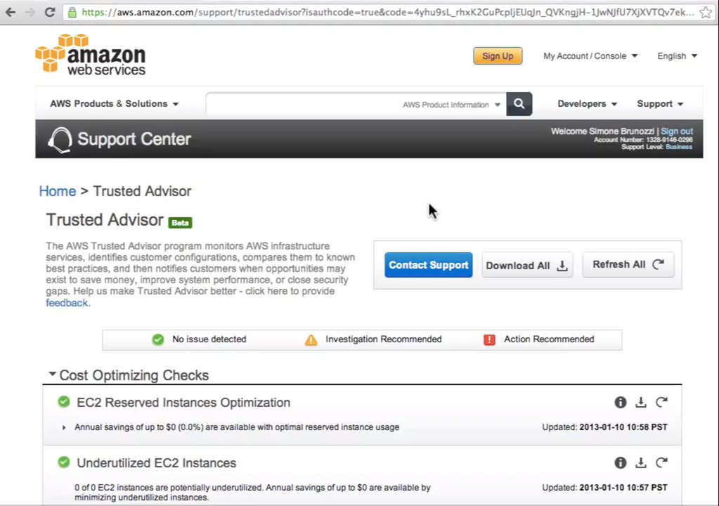

Slide 47
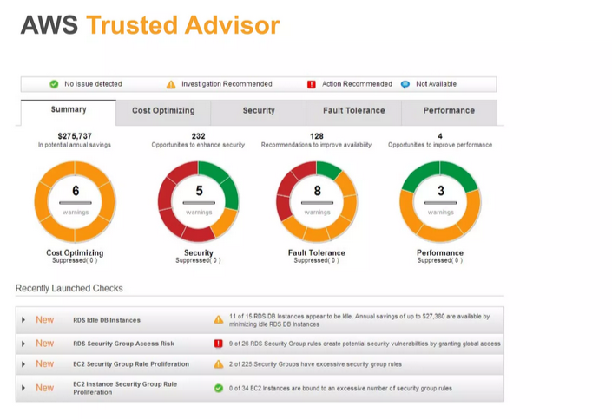

Slide 48
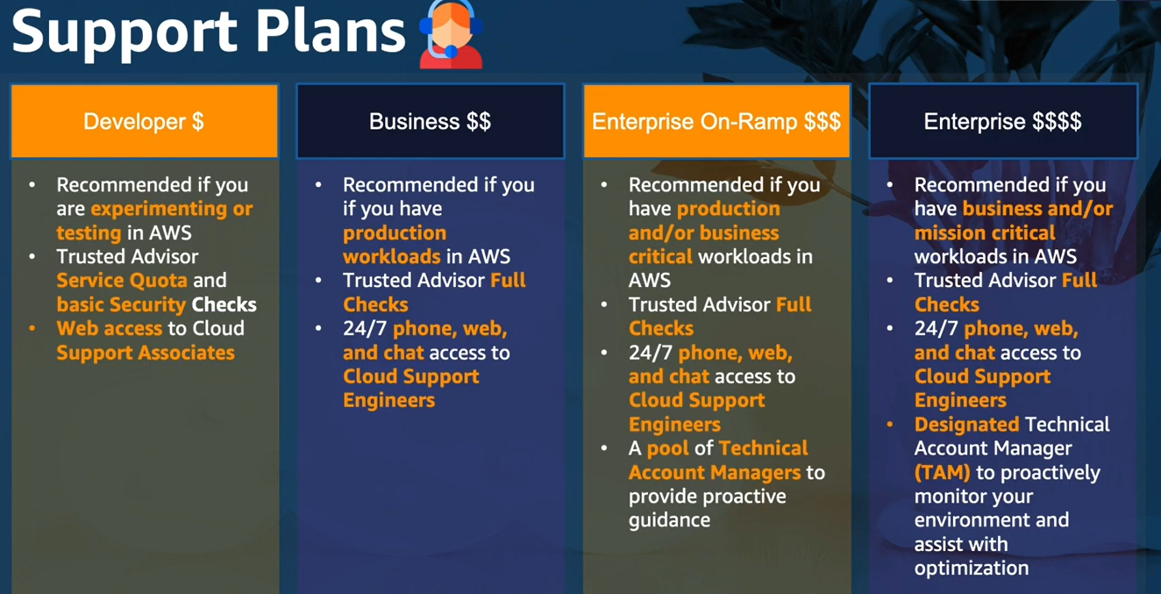

Slide 49
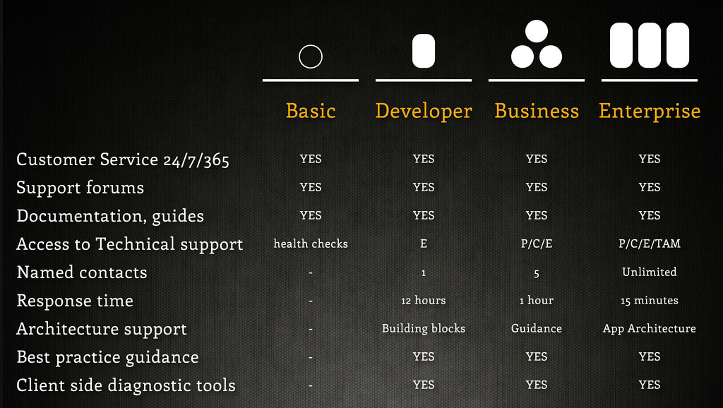

Slide 50
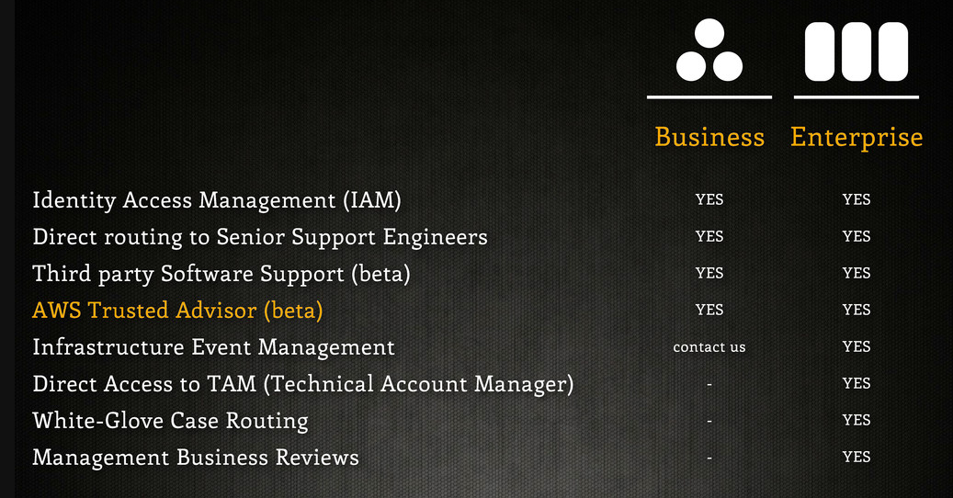

Slide 51
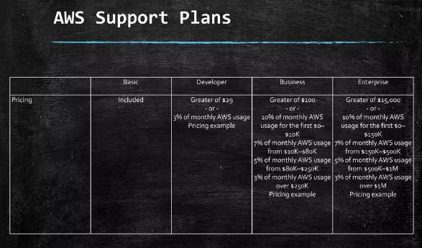

Slide 52
AWS Support Plans
Basic support (free)
Developer Plan
Business Plan
Enterprise On-Ramp Plan
Enterprise Plan

Slide 53
AWS Support Plans
Basic support
Customer Service & Communities - 24x7 access to customer service, documentation, whitepapers, and support forums.
AWS Trusted Advisor – Limited
AWS Personal Health Dashboard

Slide 54
AWS Support Plans
Developer Support Plan
All basic support plan +
Email access to cloud support
General guidance: < 24 business hours
System impaired: < 12 business hours

Slide 55
AWS Support Plans
Business Support Plan
Minimum recommended tier if you have a product
All developer support plan +
Trusted Advisor – Full Set
24x7 phone, email, and chat access to Cloud Support Engineers
General guidance: < 24 business hours
System impaired: < 12 business hours
Production system impaired: < 4 hours
Production system down: < 1 hour

Slide 56
AWS Support Plans
Enterprise On-Ramp Support Plan
Recommended if you have a production or business critical workload
All business support plan +
Access to a pool of Technical Account Managers (TAM)
Infrastructure Event Management, Well-Architected & Operations Reviews
General guidance: < 24 business hours
System impaired: < 12 business hours
Production system impaired: < 4 hours
Production system down: < 1 hour
Business-critical system down: < 30 minutes

Slide 57
AWS Support Plans
Enterprise Support Plan
Recommended if you have a mission critical workloads
All business support plan +
Access to a designated Technical Account Manager (TAM)
General guidance: < 24 business hours
System impaired: < 12 business hours
Production system impaired: < 4 hours
Production system down: < 1 hour
Business-critical system down: < 15 minutes

Slide 58


Slide 59


Slide 60
AWS Well-Architected
Helps cloud architects to build efficient, secure, and high performing infrastructure.
6 Pillars
1) Operational Excellence
2) Security
3) Reliability
4) Performance Efficiency
5) Cost Optimization
6) Sustainability

Slide 61


AWS Well-Architected Framework:
The AWS Well-Architected Framework is a set of best practices that can help you design, operate, and optimize your workloads on the AWS cloud. It consists of five pillars:
1. Operational Excellence
* Key principles: Run workloads effectively, reliably, and efficiently.
* Focus areas:
* Logging and monitoring
* Automation
* Change management
* Incident response

Slide 62
AWS Well-Architected
1) Operational Excellence : Includes the ability to run and monitor systems to deliver business value and to continually improve supporting processes and procedures
Perform operations as code
Annotate documentation
Make frequent, small, reversible changes
Refine operations procedures frequently
Anticipate failure
Learn from all operational failures

Slide 63


AWS Well-Architected Framework:
2. Security
* Key principles: Protect information, systems, and data.
* Focus areas:
* Identity and access management (IAM)
* Data protection
* Network security
* Security assessments

Slide 64
AWS Well-Architected
2) Security: Includes the ability to protect information, systems, and assets while delivering business value through risk assessments and mitigation strategies
Automate security best practices
Apply security at all layers
Protect data in transit and at rest

Slide 65


AWS Well-Architected Framework:
3 . Reliability
* Key principles: Ensure workloads are resilient and available.
* Focus areas:
* Fault tolerance
* Change management
* Monitoring
* Backup and recovery

Slide 66
AWS Well-Architected
3) Reliability: Ability of a system to recover from infrastructure or service disruptions.
Automatically recover from failure.
Test recovery procedures.
Scale horizontally to increase aggregate system availability.
Dynamically acquire computing resources to meet demand.

Slide 67


AWS Well-Architected Framework:
4. Performance Efficiency
* Key principles: Optimize resource utilization and performance.
* Focus areas:
* Cost optimization
* Performance testing
* Resource sizing
* Efficiency improvements

Slide 68
AWS Well-Architected
4) Performance Efficiency: Includes the ability to use computing resources efficiently to meet system requirements, and to maintain that efficiency as demand changes and technologies evolve.
Go global in minutes
Use serverless architectures
Experiment more often

Slide 69

AWS Well-Architected Framework:
5. Cost Optimization
* Key principles: Spend wisely and avoid unnecessary costs.
* Focus areas:
* Rightsizing resources
* Reserved instances and Savings Plans
* Cost allocation tags
* Cost optimization tools

Slide 70
AWS Well-Architected
5) Cost Optimization: Includes the ability to run systems to deliver business value at the lowest price point
Adopt a consumption mode
Stop spending money on data center operations
Analyze and attribute expenditure

Slide 71
AWS Well-Architected
6) Sustainability: focuses on minimizing the environmental impacts of running cloud workloads.
Understand your impact
Maximize utilization
Reduce the downstream impact of your cloud workloads
Establish sustainability goals

Slide 72
Benefits of using the AWS Well-Architected Framework:
* Improved reliability: By following the framework, you can ensure that your workloads are resilient and available.
* Enhanced security: The framework helps you protect your information, systems, and data.
* Optimized performance: The framework guides you to optimize resource utilization and performance.
* Lower costs: By following the cost optimization principles, you can reduce your AWS spending.
* Increased efficiency: The framework helps you streamline your operations and avoid unnecessary overhead.

Slide 73
How to use the AWS Well-Architected Framework:
* Assess your workloads: Evaluate your existing workloads against the five pillars of the framework.
* Identify gaps: Determine areas where your workloads fall short of the best practices.
* Develop an action plan: Create a plan to address the identified gaps and improve your workloads.
* Implement changes: Implement the necessary changes to your workloads.
* Continuously monitor and improve: Regularly review your workloads against the framework and make ongoing improvements.

Slide 74


Slide 75


Slide 76


Slide 77


Slide 78


Slide 79


Slide 80


Slide 81


Slide 82


Slide 83
Questions
1-What is the most cost-effective option to have 24x7 phone, email, and chat support?
Basic Support Plan
Developer Support Plan
Enterprise Support Plan
Business Support Plan
Notes:
D. Business Support Plan

Slide 84
Questions
2- What can you use to estimate the cost of your architecture solution?
Pricing Calculator
Cost and Usage Reports
Total Cost of Ownership (TCO)
Trusted Advisor
Notes:
A. Pricing Calculator

Slide 85
Questions
3- The Enterprise Support Plan comes with a business-critical system down response under 15 minutes and offers access to a Technical Account Manager
True
False
Notes:
A. True

Slide 86
Questions
4- A company is not sure whether or not it is cost-effective to migrate to the AWS Cloud. Which service can help the executive board make a decision?
Billing Dashboard
Support Plans
Pricing Calculator
AWS Documentation
Notes:
c. Pricing Calculator

Slide 87
Questions
5- What can you use to get alerts when your costs and usage are exceeding or are forecasted to exceed your budgeting amount?
Cost and Usage Reports
Billing Dashboard
Pricing Calculator
Budgets
Notes:
D. Budgets

Slide 88
Questions
6- When you reserve, the larger the upfront payment, the smaller the discount.
True
False, the upfront payment does not matter on the discount
False, the larger the upfront, the bigger the discount
Notes:
C. False, the larger the upfront, the bigger the discount

Slide 89
Questions
7- Which of the following are design principles of Performance Efficiency?
Go global in minutes & Use serverless architectures
Adopt a consumption mode & Stop spending money on data center operations
Understand your impact & Maximize utilization
Perform operations as code
Notes:
A. Go global in minutes & Use serverless architectures

Slide 90
Questions
8- Testing recovery procedures, and automatically recover from failure are design principles of Performance Efficiency.
True
False
Notes:
B. True

Slide 91
Questions
9- Automate security best practices, apply security at all layers, and protect data in transit and at rest are design principles of:
Operational Excellence
Security
Reliability
Performance Efficiency
Notes:
B. Security

Slide 92
Questions
10- AWS Trusted Advisor comes with Full checks in the Developer Support Plan
True
False
Notes:
B. False

Slide 93

Notes:
AURI
NURI
PURI

Slide 94

Notes:
AWS Cost Explorer

Slide 95

Notes:
false

Slide 96

Notes:
Storage is typically charged by gigabyte

Slide 97

Notes:
Basic, Developer, Business, Enterprise

Slide 98

Notes:
AWS pricing Calculator

Slide 99

Notes:
Economics of scale

Slide 100

Notes:
true

Slide 101

Notes:
Provides the ability to create groups of accounts and then attach policies to agroup
Simplifies automating account creation and management by using APIs

Slide 102

Notes:
False

Slide 103
THANK YOU

